Slide 1

Exam AZ-304: Microsoft Azure Architect Design Crash Course
Tim Warner

Slide 2


Tim Warner
Based in Nashville, TN, US
Central time zone
MCT, MVP
Twitter: @TechTrainerTim
Badge: TechTrainerTim.com

Slide 3
Day 1 of 2 Agenda
Introduction
Azure infrastructure design (25-30%)
Business continuity design (10-15%)
Monitoring design (10-15%)

Slide 4
Day 2 of 2 Agenda
Content catch-up
Identity and security design (25-30%)
Data storage design (15-20%)
Exam AZ-304 strategy

Slide 5
Course Materials
timw.info/az304

Slide 6
Expectations
We'll learn by doing – at least 80 percent demo
Visual, case study approach
This is an expert certification, so we move quickly and assume intermediate-level Azure skills
10-minute break at midpoint
I’m here to answer your questions – take advantage of this!
Use the Q&A panel

Slide 7
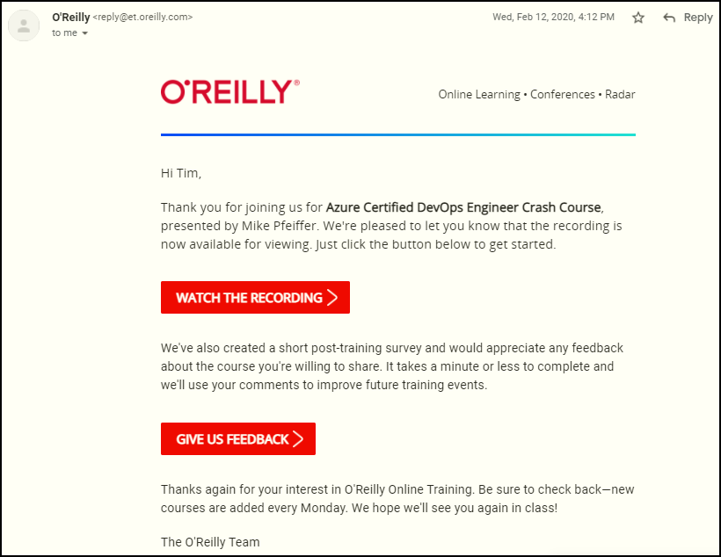
Session Recordings

Slide 8

Session Recordings

Slide 9

Session Recordings

Slide 10

Session Recordings

Slide 11


Session Recordings

Slide 12
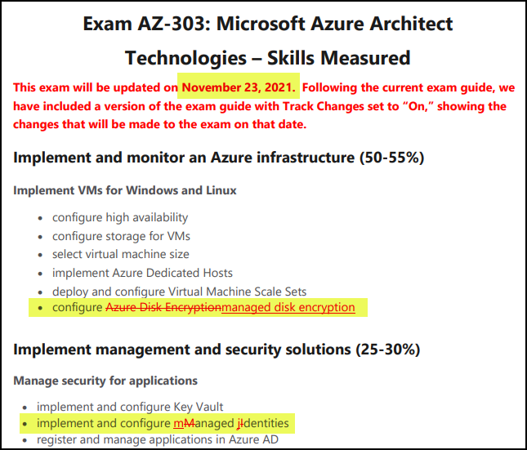
Azure Architect Cert Latest Changes

Slide 13
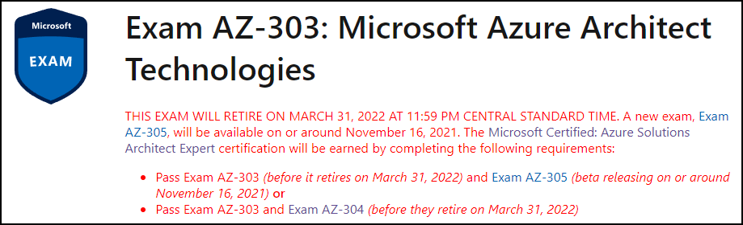
Azure Architect Cert Latest Changes
timw.info/qwb

Slide 14
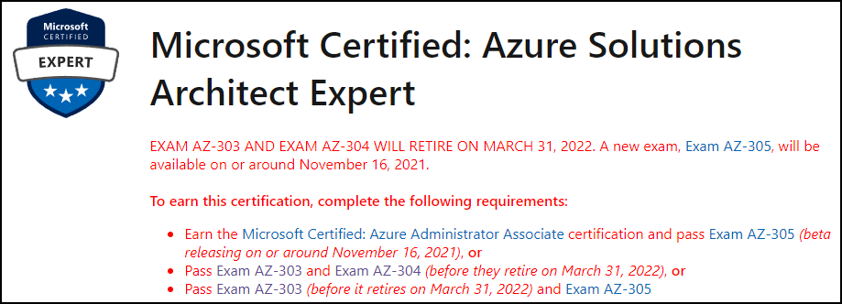
Azure Architect Cert Latest Changes
timw.info/qwb

Slide 15
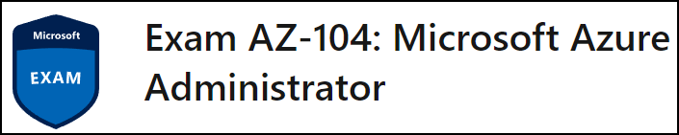
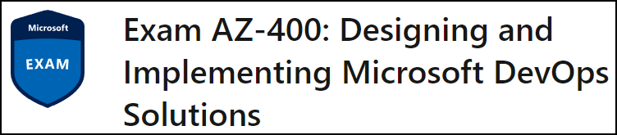
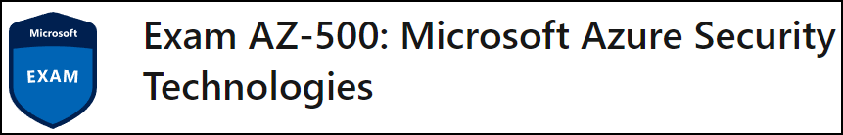
Related Certification Exams

Slide 16

Tim's Certification Study Model

Slide 17
Thank you!
Course materials: timw.info/az303
Twitter: @TechTrainerTim
Work: timw.info/ps
Web: TechTrainerTim.com

Slide 18
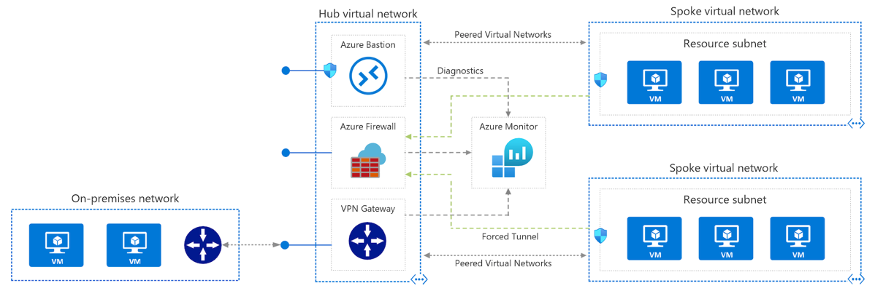
Azure VNet Hub-Spoke

Slide 19
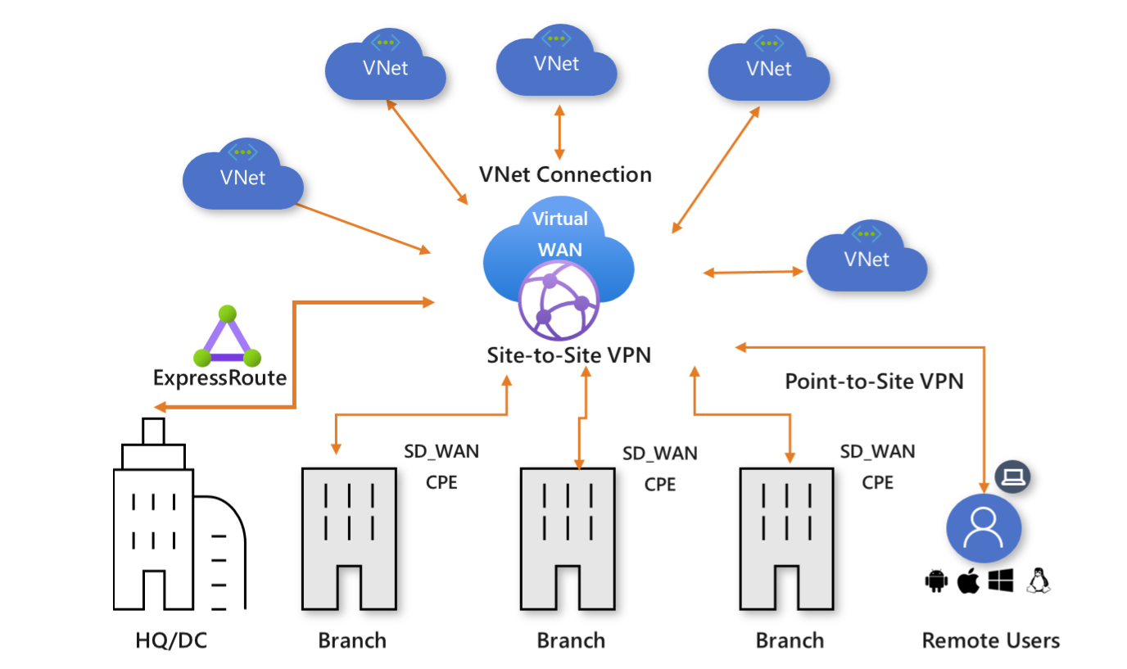
Azure Virtual WAN

Slide 20
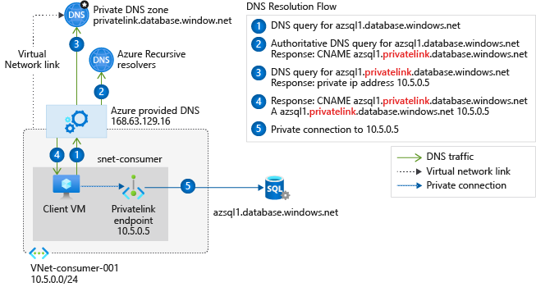
Private Link DNS Configuration

Slide 21

Azure Backup

Slide 22
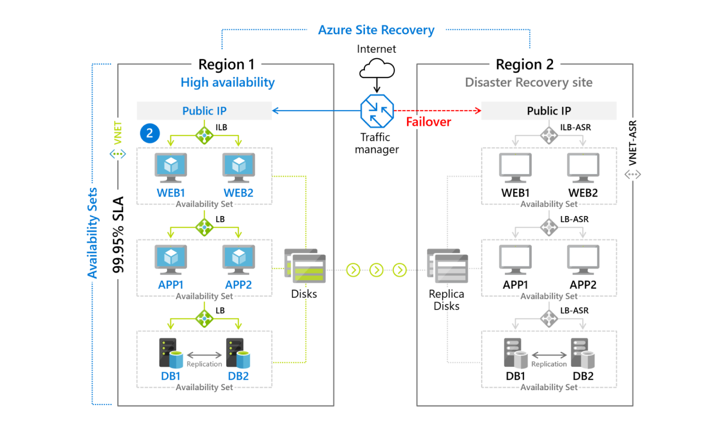
Azure Site Recovery

Slide 23

VM Scale Sets

Slide 24
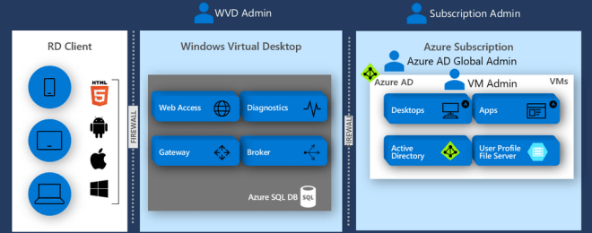
Windows Virtual Desktop (WVD)
timw.info/travis

Slide 25

Availability Set

Slide 26

Availability Zone

Slide 27

VM Networking

Slide 28

Load Balancing

Slide 29

VNet Peering

Slide 30

Hybrid Networking

Slide 31

Network Virtual Appliance

Slide 32

Azure Load Balancer

Slide 33

Application Gateway

Slide 34

Traffic Manager

Slide 35

Front Door Service

Slide 36


Docker Container Lifecycle
https://timw.info/3635f

Slide 37
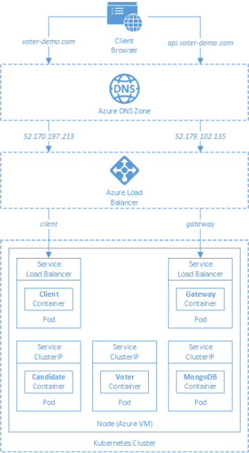
AKS

Slide 38
Azure Backup

Slide 39

Azure Site Recovery

Slide 40
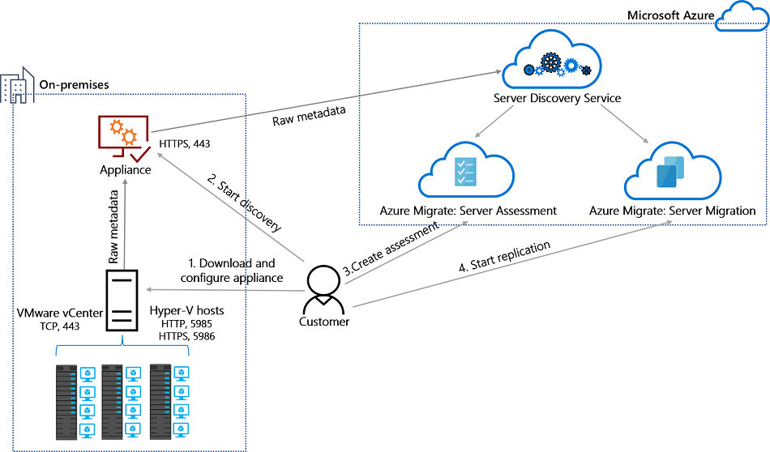
Azure Migrate

Slide 41
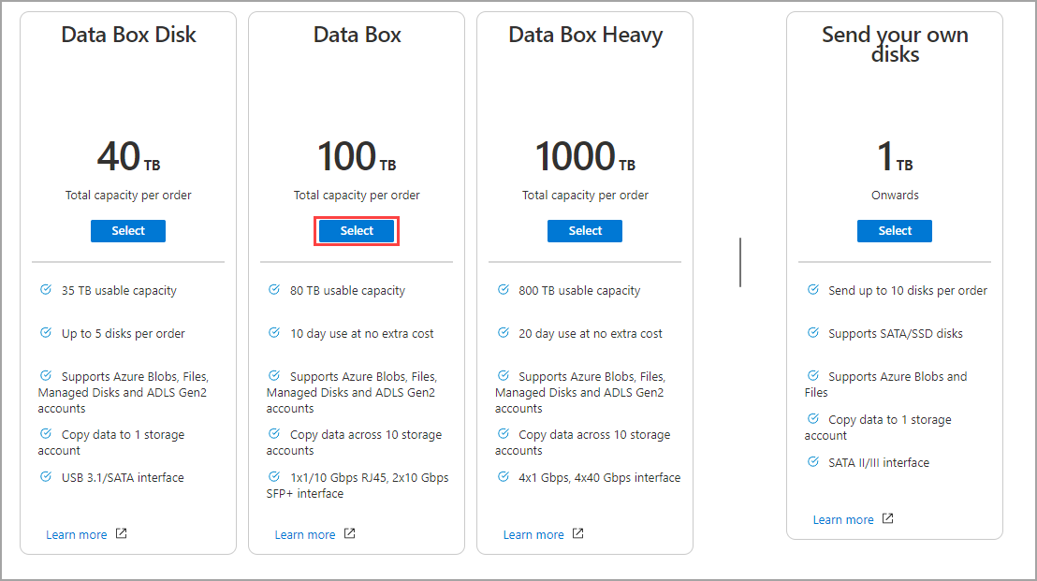
Azure Data Box

Slide 42

Azure Monitor

Slide 43

Log Analytics

Slide 44

Sentinel

Slide 45

Tenant vs. Subscription

Slide 46

Hybrid Identity

Slide 47

Azure AD B2C

Slide 48
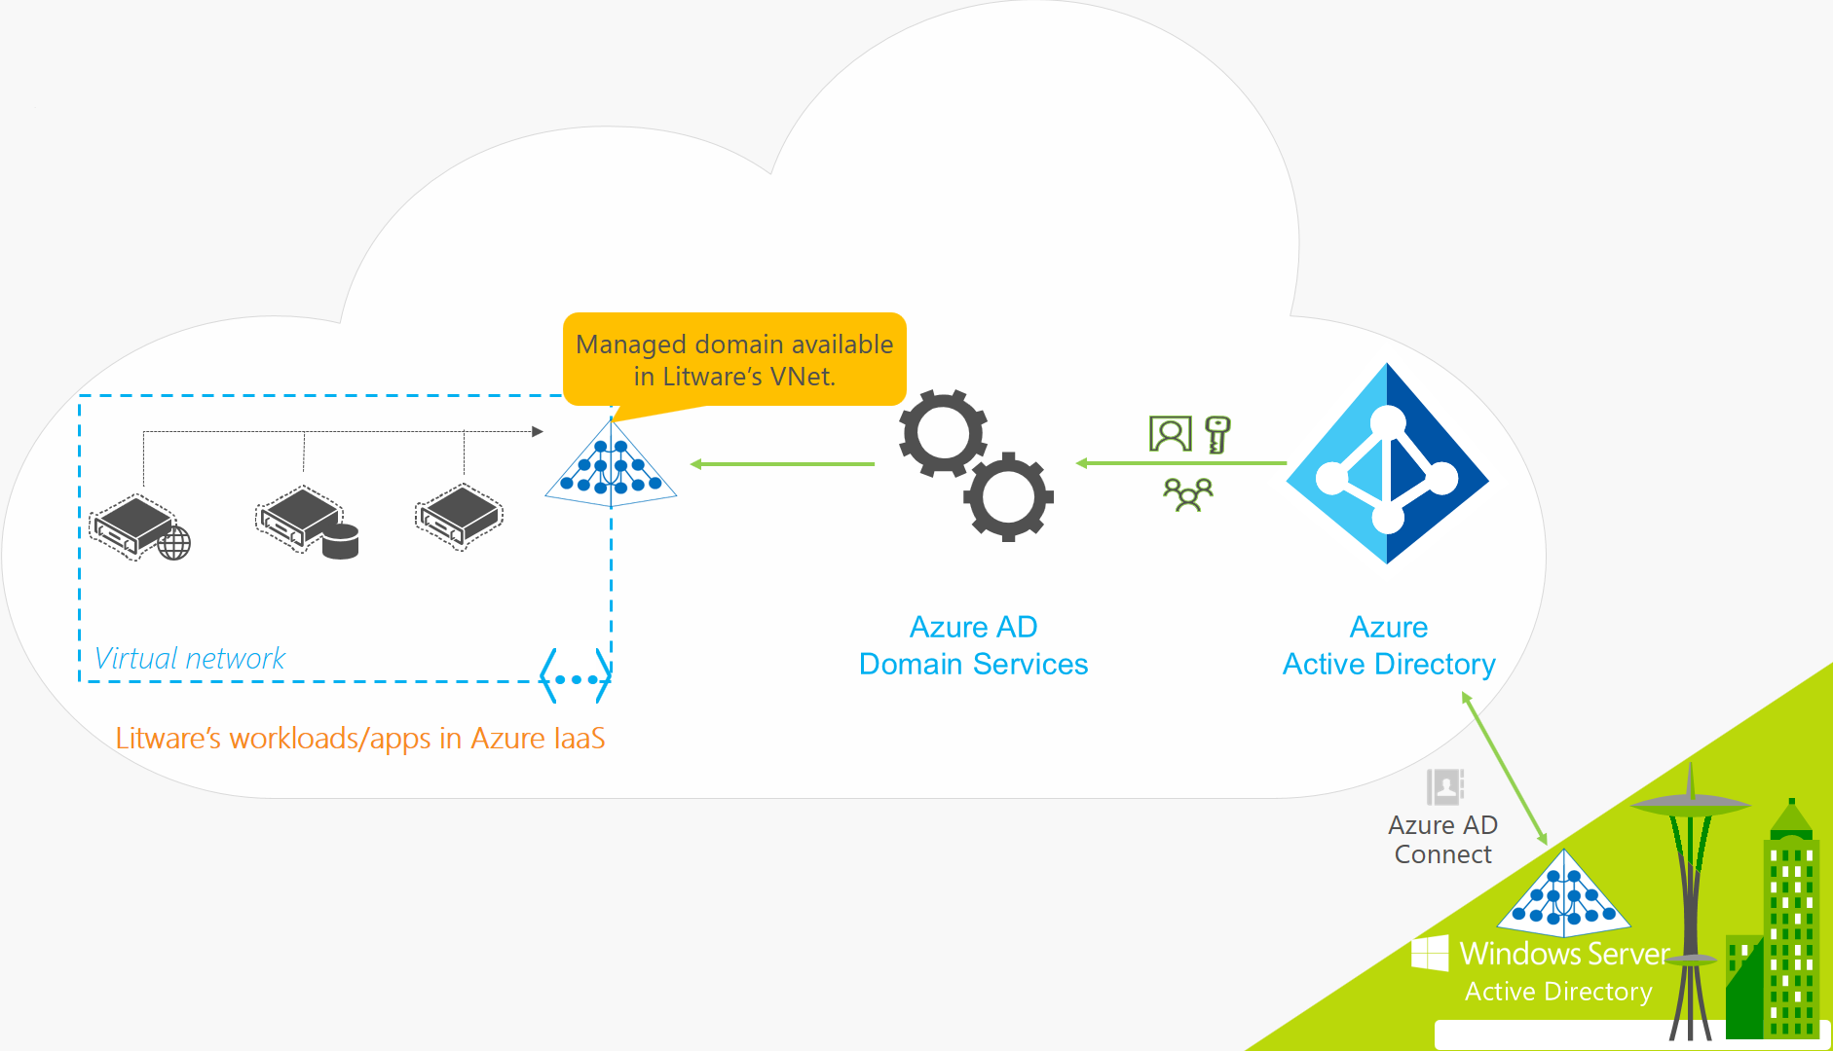
Azure AD Domain Services

Slide 49

Pass-through Authentication

Slide 50

Seamless Single Sign-on

Slide 51

Azure Management Scopes
/ Tenant Root

Slide 52

Data Pipelines

Slide 53
Storage Account Replication
1
3
3
2
LRS
ZRS

Slide 54
Storage Account Replication
3
3
GRS/RA-GRS

Slide 55
Storage Account Replication
1
3
1
3
2
2
GZRS – RA/GZRS

Slide 56

Always Encrypted

Slide 57
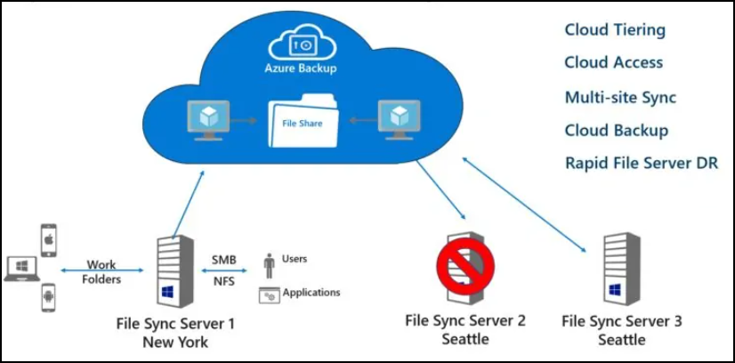
Azure File Sync

Slide 58
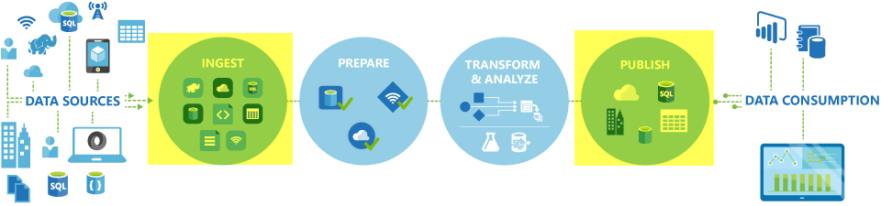
Azure Data Factory

Slide 59

Event Architecture

Slide 60

Event Architecture

Slide 61
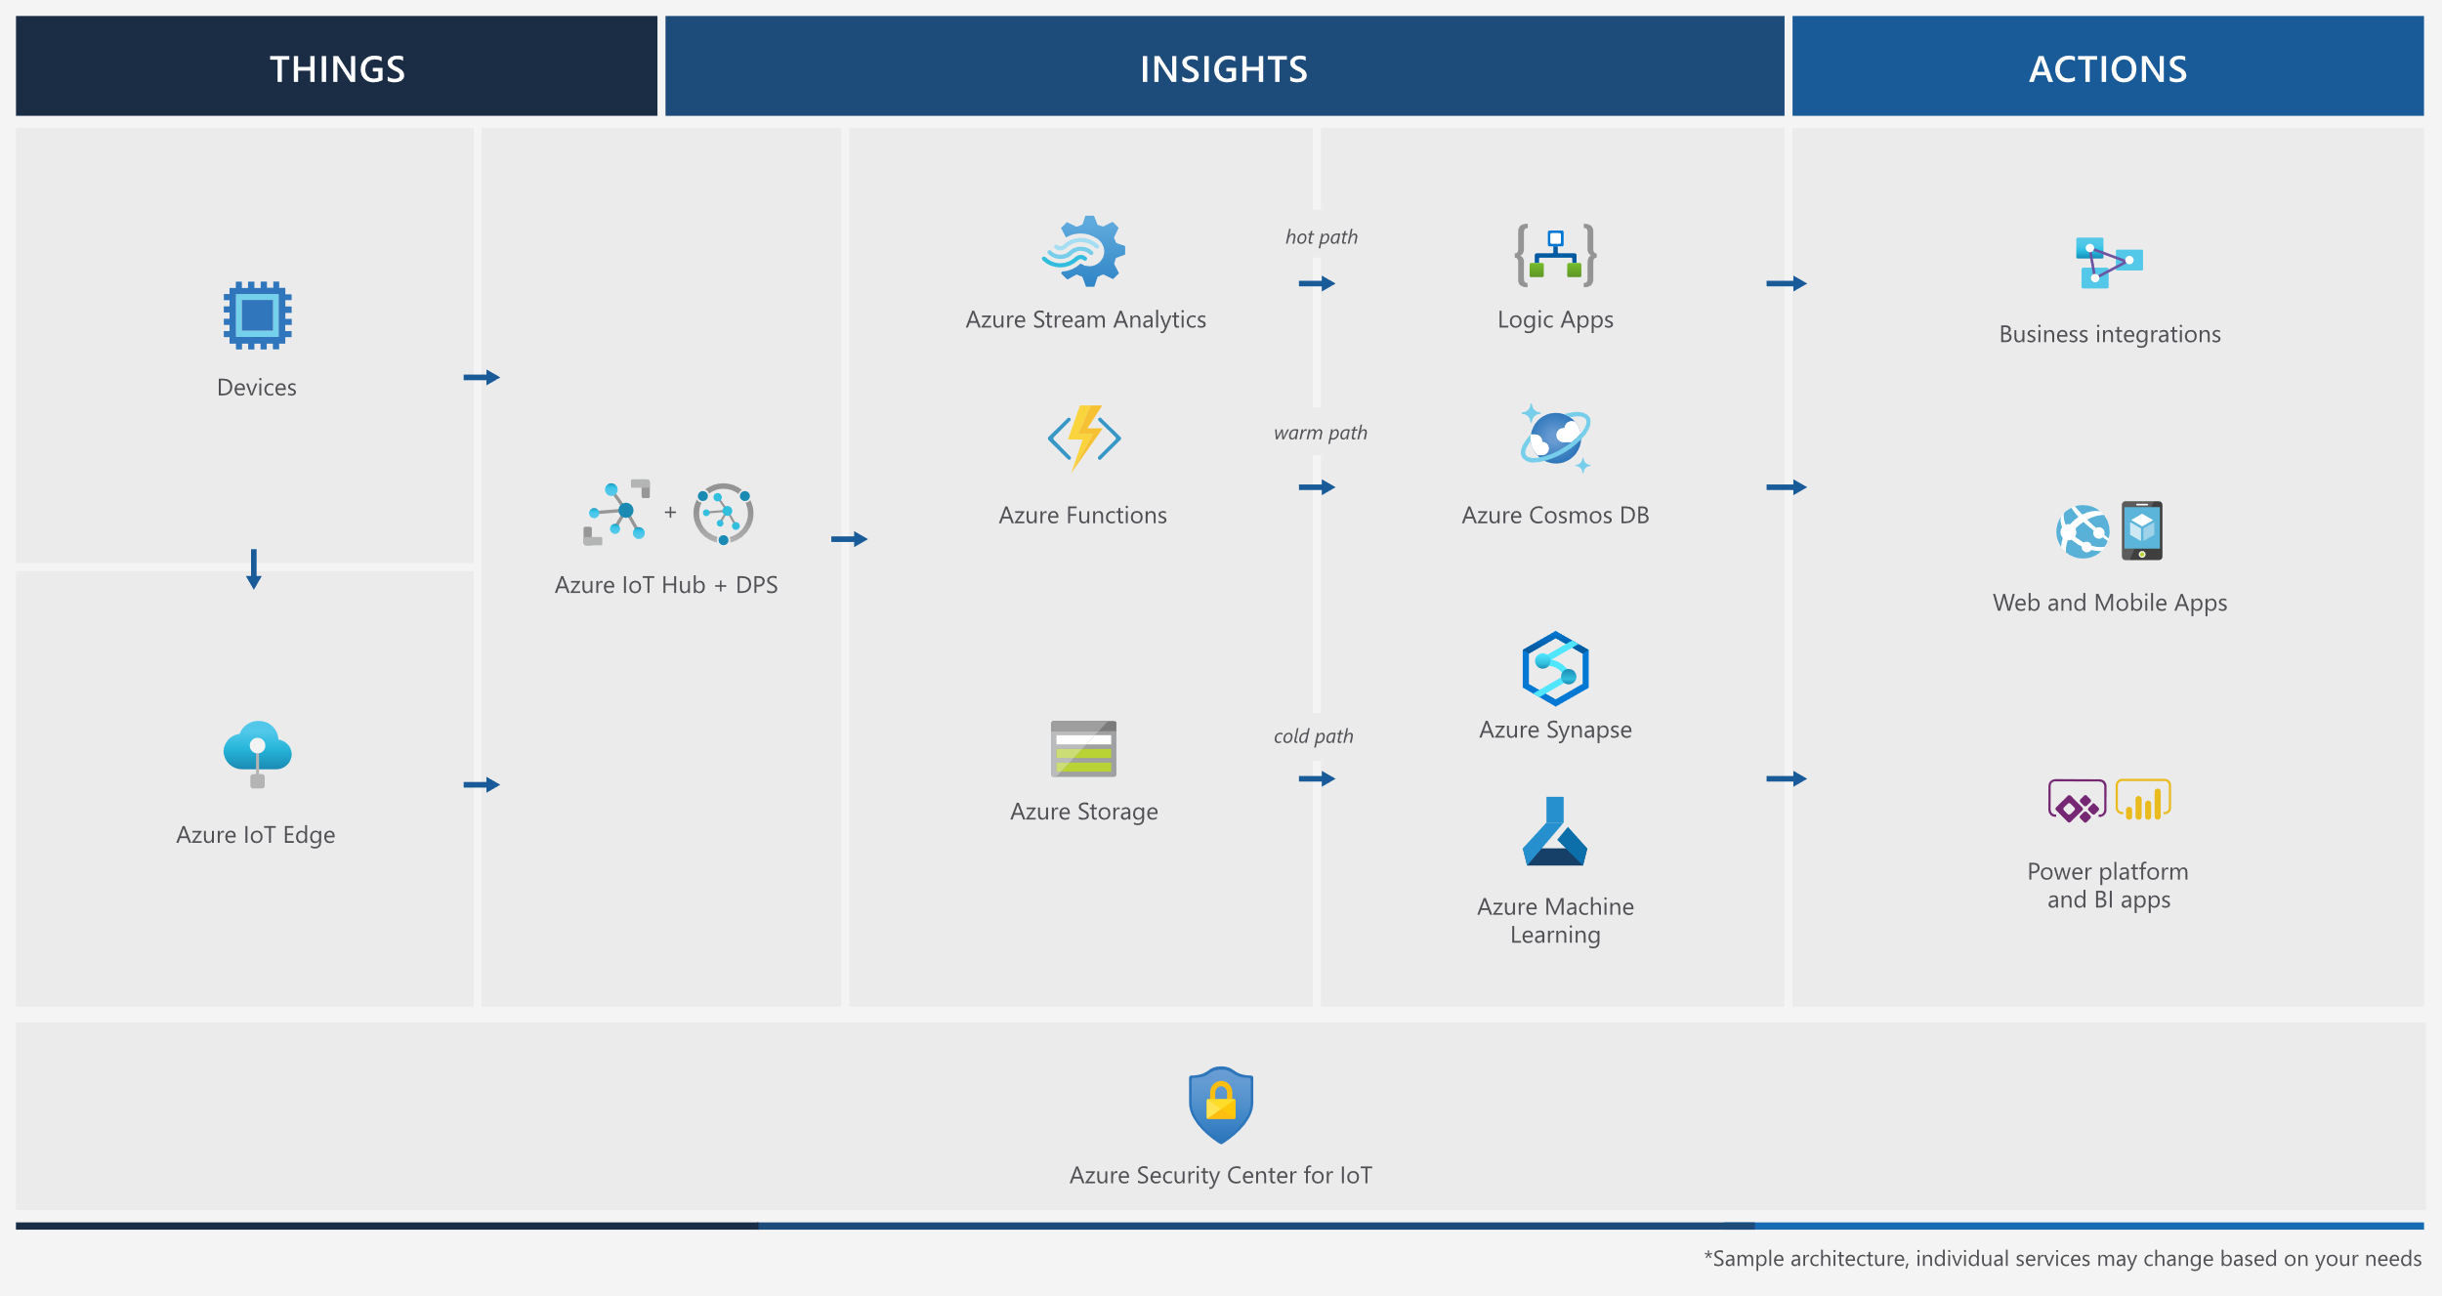
Event Architecture

Slide 62
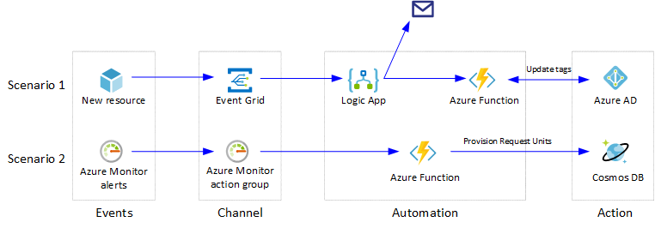
Event Architecture

Slide 63
Exam AZ-304 Item Types

Slide 64

Multiple Choice

Slide 65
Repeated Scenario
You need to move an Azure VM to another hardware host.
Solution: You redeploy the VM.
Does this solution meet the goal?
Yes
No

Slide 66

Select and Place

Slide 67

Build List and Reorder

Slide 68

Active Screen/Fill in the Blank

Slide 69

Case Study

Slide 70






Performance-Based Lab

Slide 71
Microsoft Online Testing

Slide 72
Microsoft Online Testing Process
timw.info/online

Slide 73

Microsoft Online Testing Process

Slide 74

Microsoft Online Testing Process

Slide 75

Microsoft Online Testing Process

Slide 76

Microsoft Online Testing Process

Slide 77

Microsoft Online Testing Process

Slide 78

Microsoft Online Testing Process

Slide 79

Microsoft Online Testing Process

Slide 80
AZ-304 Exam Strategy
Focus your skills accordingly:
60 percent Azure portal
20 percent Azure PowerShell
10 percent Azure CLI
10 percent KQL
Expect performance-based labs, but be thankful if you don't see 'em

